Slide 1

Dungeon Crawler
1
A Java terminal game: explore, fight, loot, and escape
Sabuhi GARIBOV
Yusif KHALAFLI
Famil GULMMAMADOV
Daniil KUCHINSKI

Slide 2
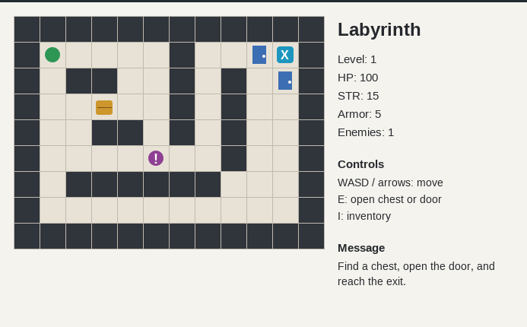
2
Introduction
Navigate mazes, face enemies, open chests, and find the exit while managing resources and risk.

Slide 3
01
3
Game Overview

Slide 4
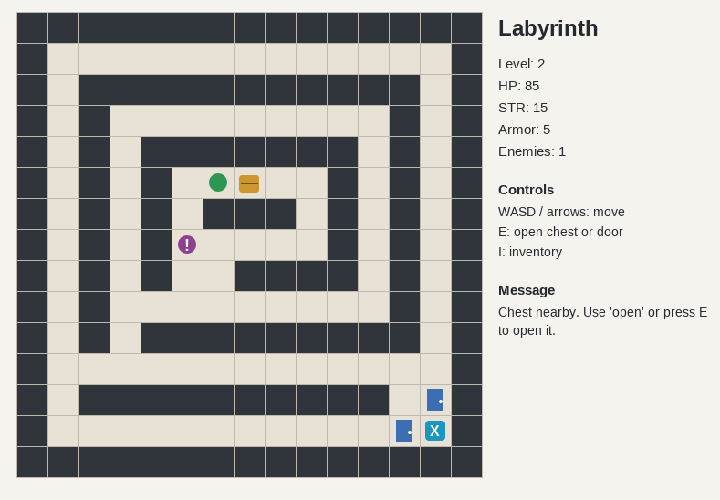
4
Concept
Turn-based, dungeon crawler with 3 levels.
Focus on simple inputs, tactical play and loot collecting to escape the labyrinth.

Slide 5
5
Core Entities
Player: the player itself. When the player makes a “legal move”, the world makes a time step.
Enemy: hostile LivingBeings. Enemies will chase the player down to a dead end. They will attack the player when moving near them.
Chests: will contain keys to open the doors to leave the labyrinth.
Doors: last obstacle to leave the labyrinth. Can be opened with keys.

Slide 6
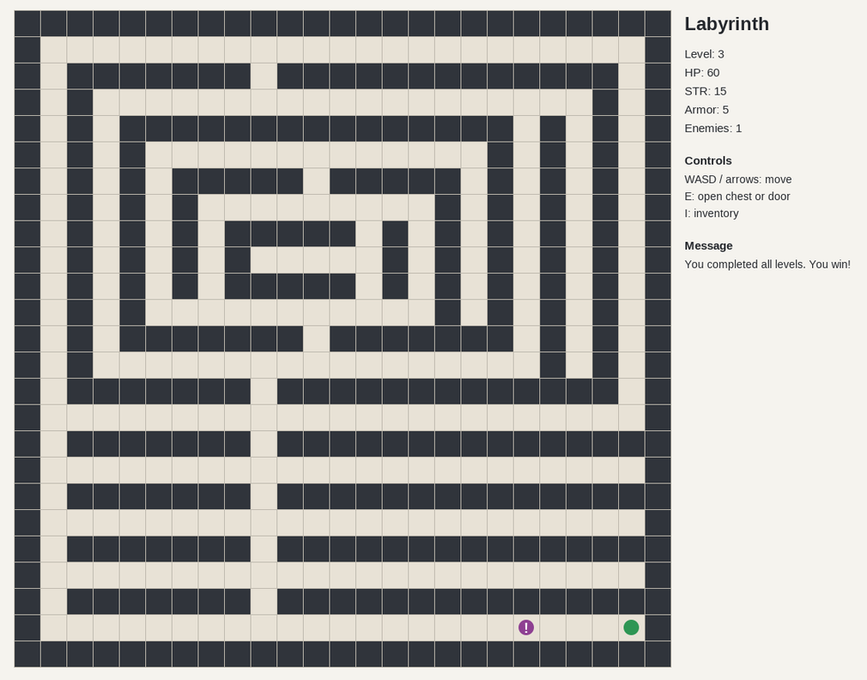
6
Objectives & Victory
The main objective is to escape the labyrinth alive.

Slide 7
7
02
Gameplay Mechanics

Slide 8
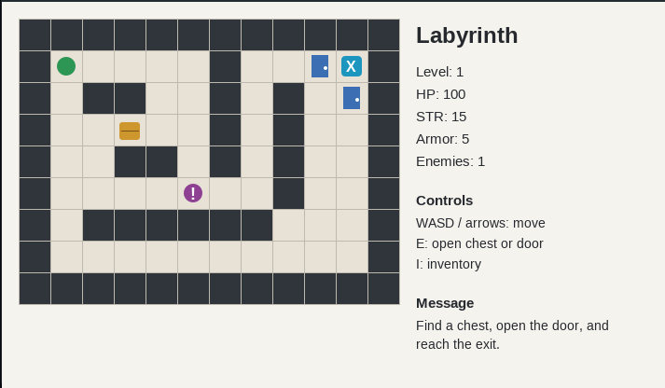
8
Player Actions
WASD/arroes to control the player.
Attack is made automatically when standing and going towards the enemy.
E to open chests and doors(if you have a key)
I to open inventory.

Slide 9
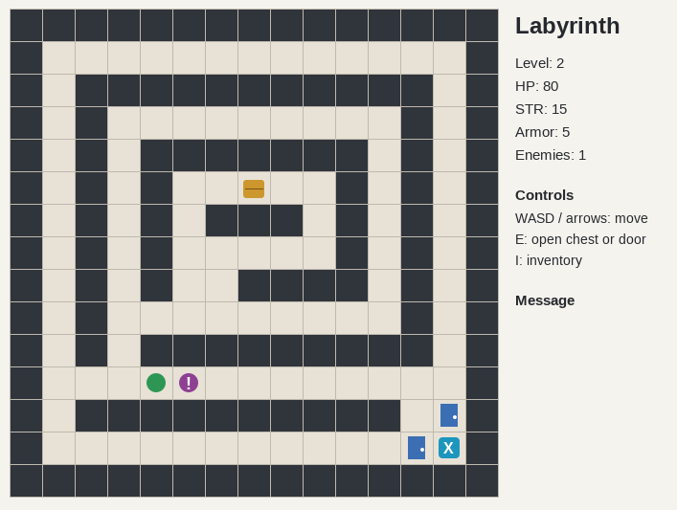
9
Enemies & AI
Enemies will chase the player down and try to attack. They have 30 HP so they will be easy to defeat

Slide 10


10
Items, Doors & Keys
Chests hold keys to open the doors. They are an obstacle, so the player and enemies can’t pass them.

Slide 11
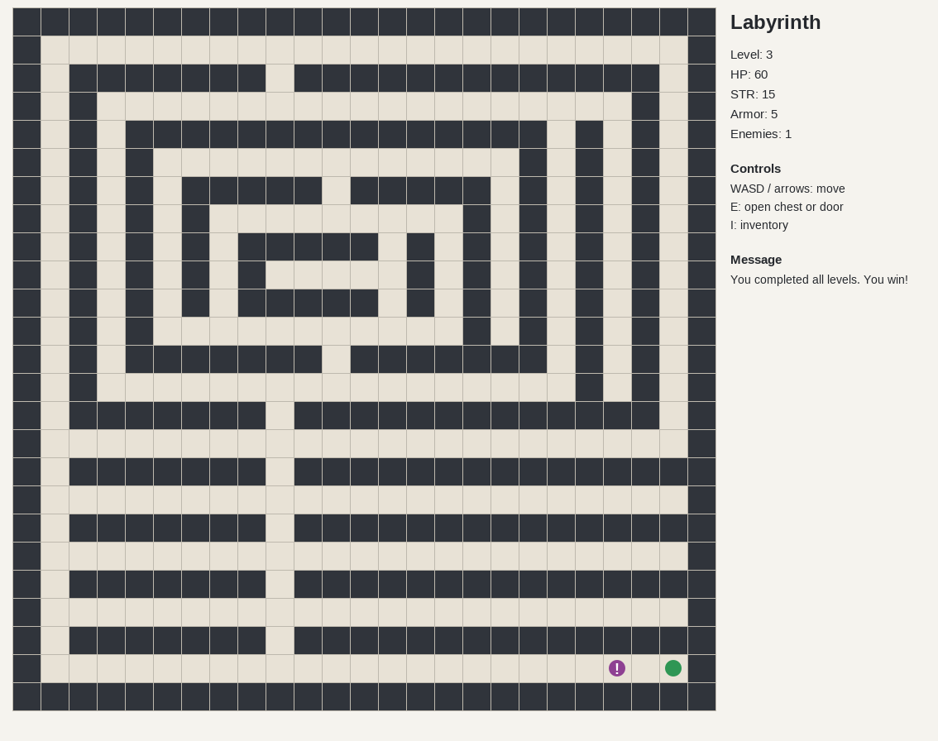
11
Conclusions
The game is simple, yet pretty fun to play. The game GUI and logic were inspired from Pacman, featuring enemies chasing players and collecting items. There are lots of features that can be added to the game so the game is also expandable

Slide 12
12
Thank you!
Sabuhi GARIBOV
Yusif KHALAFLI
Famil GULMAMMADOV
Daniil KUCHINSKI.

